Slide 1
Тэмдэгт мөртэй ажиллахад түгээмэл ашигладаг функцууд
М.Янжиндулам

Slide 2
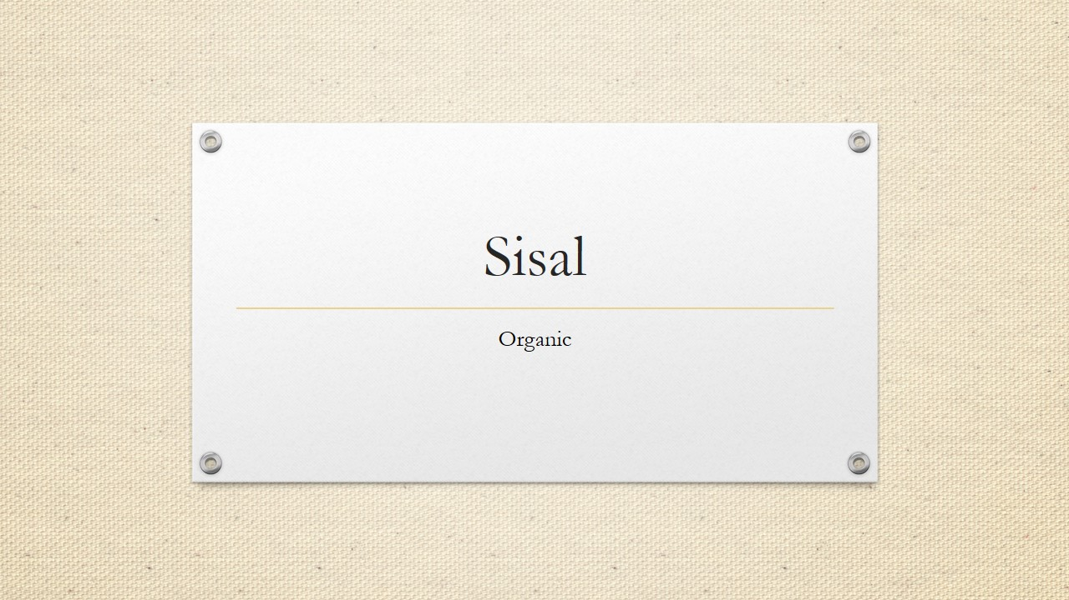
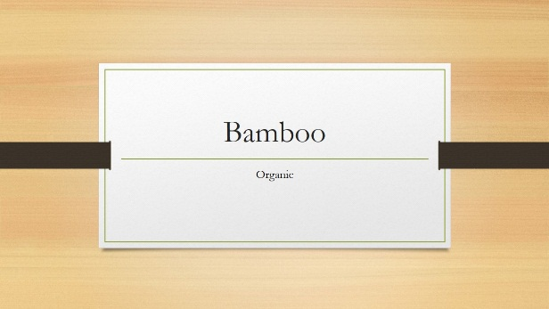

Design
Right from the start, you’ll have access to beautiful, widescreen themes that you can easily change to match your style. Every theme comes with a variety of color variants that you can mix and match.
New features like Merge Shapes and a color-matching Eyedropper open up new possibilities for your designs.
Line up your layouts, photos, and diagrams perfectly in seconds with alignment guides and smart guides.

Slide 3
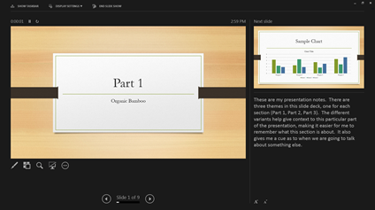

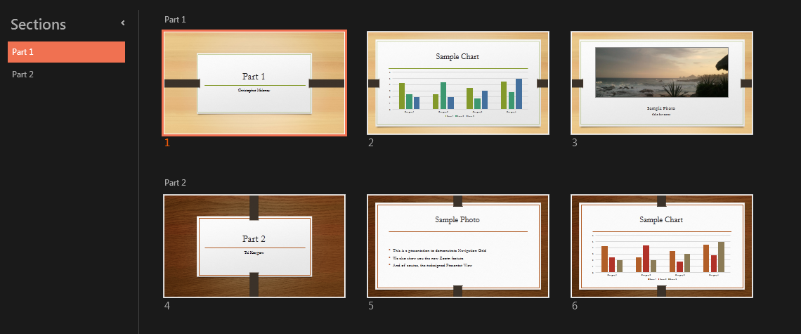

Impress
The improved Presenter View has new tools to keep you in control. The new Auto-Extend instantly applies the right settings for you, so you can focus on speaking instead of your display.
Slide zoom – Help focus your audience on your ideas. Just click to zoom in and out on a specific diagram, chart or graphic.
Slide Navigator – A feature that enables the user to visually browse for and navigate to other slides without leaving Slide Show view. Your audience only sees the slide you’re presenting.

Slide 4
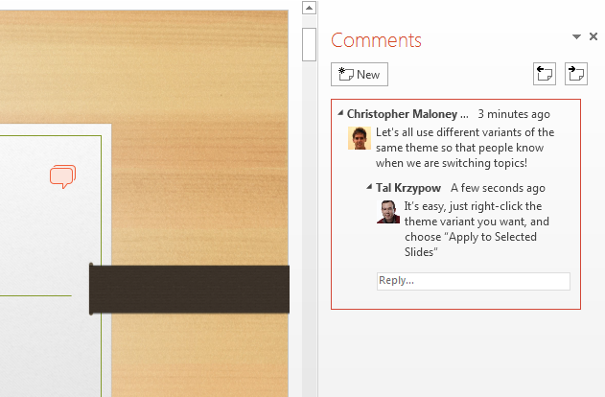
Work Together
Edit with others from different PCs at the same time and have conversations with improved commenting.
Sharing online is simple. Even if your audience doesn’t have PowerPoint, simply project to their browser with Present Online.
Work together with others at the same time from different locations, whether you are using PowerPoint on your desktop or PowerPoint Online.

Slide 5
PowerPoint 2013
Intuitively design beautiful presentations, easily share and work together with others and give a professional performance with advanced presenting tools.
Find out more at the PowerPoint Getting Started Center
(Click the arrow when in Slide Show mode)
Notes:
In Slide Show mode, click the arrow to enter the PowerPoint Getting Started Center.

